Slide 1
Interpreting scatter graphs
Graphical representations of data

Slide 2
how to use Oak lessons

Slide 3
I can interpret scatter graphs using data points shown.

Slide 4
Interpolation is the process of estimating unknown values that are inside the range of existing data.
Extrapolation is the process of estimating unknown values that are outside the range of existing data.

Slide 5

Interpreting scatter graphs
Observing trends in scatter graphs
Using trends and interpolation to make predictions

Slide 6
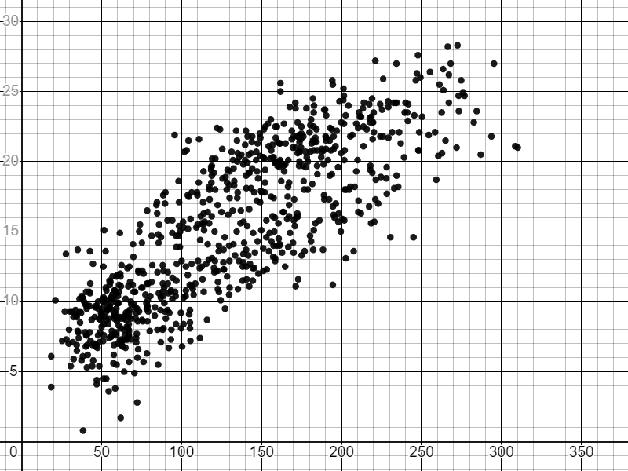
Observing trends in scatter graphs
The scatter graph shows data from the Met Office about the weather in Heathrow for each month from 1941 to 2022.
What observations could we make from this data?
mean of daily maximum temperature (℃)
Does there appear to be a connection between the two variables?
total sunshine duration (hours)

Slide 7
Observing trends in scatter graphs
We can interpret what points in different sections of the graph tell us about the variables for those months.
low amounts of sunshine and high temperatures
high amounts of sunshine and high temperatures
mean of daily maximum temperature (℃)
high amounts of sunshine and low temperatures
low amounts of sunshine and low temperatures
total sunshine duration (hours)

Slide 8
Observing trends in scatter graphs
Most of the points for this data are in these two zones.
high amounts of sunshine and high temperatures
mean of daily maximum temperature (℃)
low amounts of sunshine and low temperatures
total sunshine duration (hours)

Slide 9
Observing trends in scatter graphs
The upward trend suggests that months with more hours of sunshine tended to be warmer than months with fewer hours of sunshine.
mean of daily maximum temperature (℃)
total sunshine duration (hours)

Slide 10
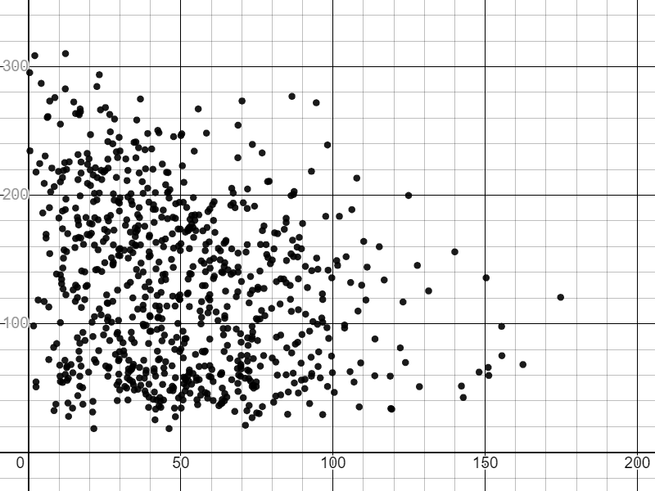
Observing trends in scatter graphs
The scatter graph shows some other data from the Met Office about the weather in Heathrow for each month from 1941 to 2022.
What observations could we make from this data?
Does there appear to be a connection between the two variables?
total sunshine duration (hours)
total rainfall (mm)

Slide 11
Observing trends in scatter graphs
This data appears to have a slight downward trend which suggests that months with more rainfall tended to have fewer hours of sunshine.
The trend is weaker than in the previous example.
total sunshine duration (hours)
The connection between the variables is less clear.
total rainfall (mm)

Slide 12
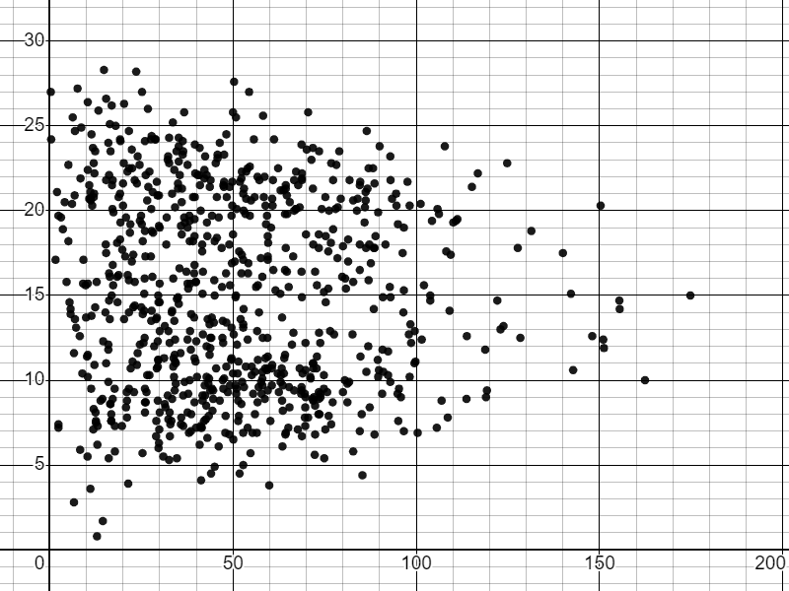
Observing trends in scatter graphs
The scatter graph shows some other data from the Met Office about the weather in Heathrow for each month from 1941 to 2022.
What observations could we make from this data?
mean of daily maximum temperature (℃)
Does there appear to be a connection between the two variables?
total rainfall (mm)

Slide 13
Observing trends in scatter graphs
There does not appear to be a trend in this data. There is not a clear connection between the variables.
mean of daily maximum temperature (℃)
total rainfall (mm)

Slide 14
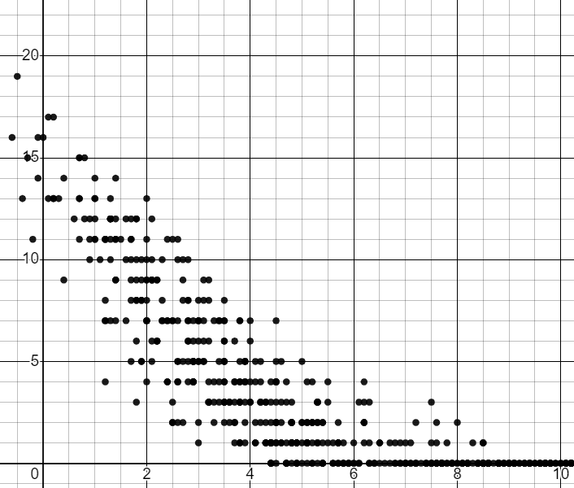

Observing trends in scatter graphs
Which statement best describes the trend in this scatter graph?
Warmer months tended to have more days with air frost.
number of days with air frost
Warmer months tended to have fewer days with air frost.
There does not appear to be a connection between the variables.
mean of daily minimum temperature (℃)

Slide 15
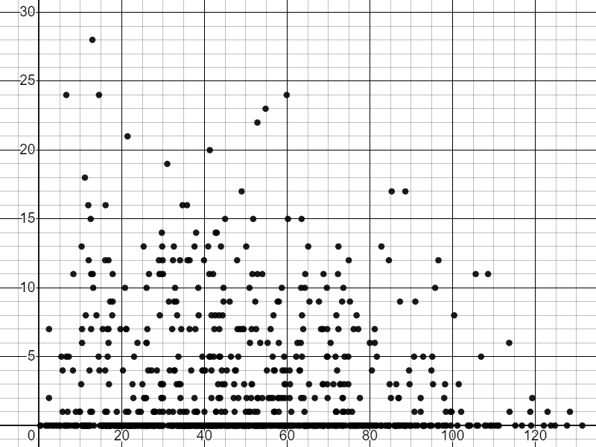
Observing trends in scatter graphs
Which statement best describes the trend in this scatter graph?
Months with more rainfall tended to have more days with air frost.
number of days with air frost
Months with more rainfall tended to have fewer days with air frost.
There does not appear to be a connection between the variables.
total rainfall (mm)

Slide 16
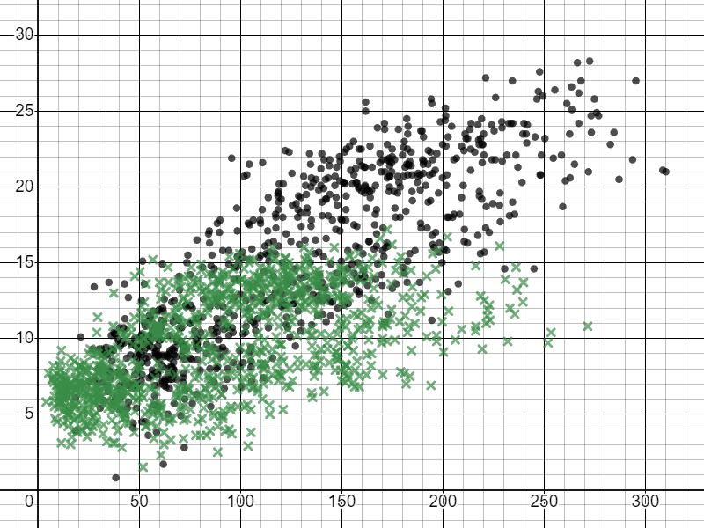
Observing trends in scatter graphs
Trends in data can sometimes distinguish one group of data from another.
key:
Heathrow (south England)
Lerwick (north Scotland)
mean of daily maximum temperature (℃)
What observations could we make from this data?
Do there appear to be any differences between the data for the two towns?
total sunshine duration (hours)

Slide 17
Observing trends in scatter graphs
Heathrow tends to have had warmer maximum temperatures than Lerwick.
key:
Heathrow (south England)
Lerwick (north Scotland)
mean of daily maximum temperature (℃)
total sunshine duration (hours)

Slide 18
Observing trends in scatter graphs
Lerwick has had more months with fewer hours of sunshine than Heathrow.
key:
Heathrow (south England)
Lerwick (north Scotland)
mean of daily maximum temperature (℃)
total sunshine duration (hours)

Slide 19
Observing trends in scatter graphs
A new datapoint records 220 hours of sunshine and a mean maximum daily temperature of 11℃. Which town is it most likely to be from?
key:
Heathrow (south England)
Lerwick (north Scotland)
mean of daily maximum temperature (℃)
Lerwick
total sunshine duration (hours)

Slide 20
Observing trends in scatter graphs
A new datapoint records 150 hours of sunshine and a mean maximum daily temperature of 18℃. Which town is it most likely to be from?
key:
Heathrow (south England)
Lerwick (north Scotland)
mean of daily maximum temperature (℃)
Heathrow
total sunshine duration (hours)

Slide 21
Observing trends in scatter graphs
A new datapoint records only 10 hours of sunshine in the month. Which town is it most likely to be from?
key:
Heathrow (south England)
Lerwick (north Scotland)
mean of daily maximum temperature (℃)
Lerwick
total sunshine duration (hours)

Slide 22
Observing trends in scatter graphs
A new datapoint records a mean maximum daily temperature of 22℃. Which town is it most likely to be from?
key:
Heathrow (south England)
Lerwick (north Scotland)
mean of daily maximum temperature (℃)
Heathrow
total sunshine duration (hours)

Slide 23
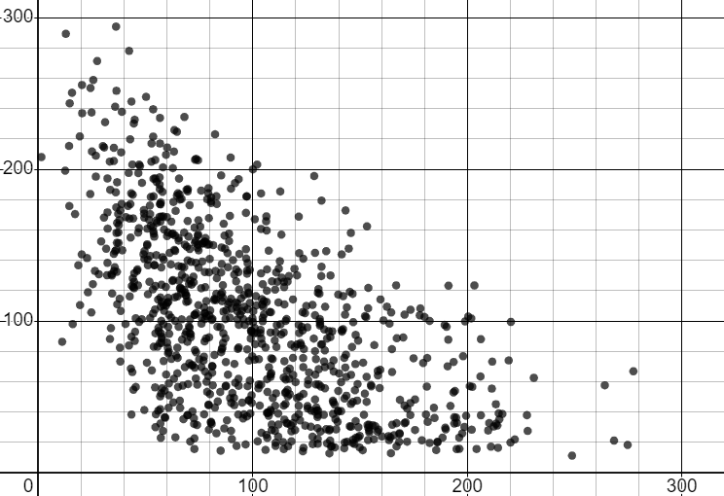
Observing trends in scatter graphs
1) The scatter graph shows data from the Met Office about the weather in Stornoway for each month from 1941 to 2022.
Write ‘true’ or ‘false’ for each statement below, based on the scatter graph.
a) Months with more rain tended to have less sunshine.
total sunshine duration (hours)
b) Months with more sunshine tended to have less rain.
c) Some months recorded no sunshine.
total rainfall (mm)
d) All of the months that had more than 150 mm of rain also had less than 200 hours of sunshine.

Slide 24
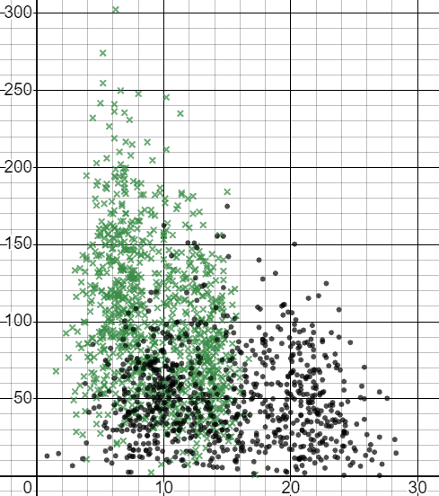
Observing trends in scatter graphs
2) The scatter graph shows data from the Met Office about the weather in two towns for each month from 1941 to 2022.
Heathrow
Lerwick
a) Which town tends to get more rainfall?
b) Which town tends to be warmer?
total rainfall (mm)
c) A new data point records 5℃ and 100 mm. Which town is it more likely to be?
d) A new data point records 20℃ and 100 mm. Which town is it more likely to be?
mean of daily maximum temperature (℃)

Slide 25
Observing trends in scatter graphs
1) The scatter graph shows data from the Met Office about the weather in Stornoway for each month from 1941 to 2022.
Write ‘true’ or ‘false’ for each statement below, based on the scatter graph.
a) Months with more rain tended to have less sunshine.
True
total sunshine duration (hours)
b) Months with more sunshine tended to have less rain.
True
False
c) Some months recorded no sunshine.
total rainfall (mm)
d) All of the months that had more than 150 mm of rain also had less than 200 hours of sunshine.
True

Slide 26
Observing trends in scatter graphs
2) The scatter graph shows data from the Met Office about the weather in two towns for each month from 1941 to 2022.
Heathrow
Lerwick
a) Which town tends to get more rainfall?
Lerwick
b) Which town tends to get warmer?
Heathrow
total rainfall (mm)
c) A new data point records 5℃ and 100 mm. Which town is it more likely to be?
Lerwick
d) A new data point records 20℃ and 100 mm. Which town is it more likely to be?
mean of daily maximum temperature (℃)
Heathrow

Slide 27
Interpreting scatter graphs
Observing trends in scatter graphs
Using trends and interpolation to make predictions

Slide 28
Using trends and interpolation to make predictions
Trends in bivariate data can be used to make predictions about one variable based on the other.
When predictions are between values that are inside the range of existing data, the process is called interpolation.
interpolation
interpolation: estimating values inside this range
inside

Slide 29
Using trends and interpolation to make predictions
The scatter graph shows data from the Met Office about the weather in Heathrow for each month from 1941 to 2022.
What range of maximum daily temperatures might we predict for a month with 200 hours of sunshine?
mean of daily maximum temperature (℃)
Between 15℃ and 25℃
total sunshine duration (hours)

Slide 30
Using trends and interpolation to make predictions
The scatter graph shows data from the Met Office about the weather in Heathrow for each month from 1941 to 2022.
The mean maximum daily temperature for a month was 10℃.
What range of sunshine duration might we predict for this month?
mean of daily maximum temperature (℃)
Between 35 and 125 hours
total sunshine duration (hours)

Slide 31
Using trends and interpolation to make predictions
What range of maximum daily temperatures might we predict for a month with 50 hours of sunshine?
between 5℃ and 10℃
mean of daily maximum temperature (℃)
between 8℃ and 15℃
between 12℃ and 22℃
total sunshine duration (hours)

Slide 32
Using trends and interpolation to make predictions
What range of maximum daily temperatures might we predict for a month with 100 hours of sunshine?
between 5℃ and 10℃
mean of daily maximum temperature (℃)
between 8℃ and 15℃
between 12℃ and 22℃
total sunshine duration (hours)

Slide 33
Using trends and interpolation to make predictions
What range of sunshine duration might we predict for a month with a mean maximum daily temperature of 20℃?
30 to 120 hours
mean of daily maximum temperature (℃)
120 to 200 hours
190 to 270 hours
total sunshine duration (hours)

Slide 34
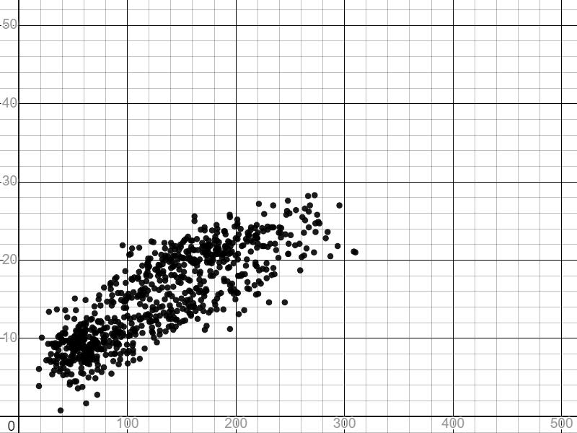

Using trends and interpolation to make predictions
Laura is using the data to predict how warm it could get if a month had a larger duration of sunshine.
If next June has 450 hours of sunshine, we would expect the mean maximum temperature to be between 40℃ and 50℃.
mean of daily maximum temperature (℃)
What problems could there be with Laura’s prediction?
total sunshine duration (hours)

Slide 35
Using trends and interpolation to make predictions
The data does not show any months with more than 310 hours of sunshine. So it is difficult to predict how temperature will respond beyond this point.
The temperature might continue to increase in the same way.
mean of daily maximum temperature (℃)
The temperature might increase at a slower rate.
The temperature might reach a maximum level.
total sunshine duration (hours)

Slide 36
Using trends and interpolation to make predictions
When predictions are made outside the range of existing data, the process is called extrapolation.
extrapolation
outside
mean of daily maximum temperature (℃)
extrapolation: estimating values outside this range
total sunshine duration (hours)

Slide 37
Using trends and interpolation to make predictions
Extrapolation is less reliable than interpolation because it involves speculating about values beyond what has previously been observed.
interpolation: estimating values inside this range
extrapolation: estimating values outside this range

Slide 38
Using trends and interpolation to make predictions
What word describes the process of estimating unknown values that are inside the range of existing data.
interpolation

Slide 39
Using trends and interpolation to make predictions
What word describes the process of estimating unknown values that are outside the range of existing data.
extrapolation

Slide 40
Using trends and interpolation to make predictions
Extrapolation is as reliable as interpolation for predicting unknown values in bivariate data.
The trend in the data will continue in the same way for values beyond what has previously been observed.
It is difficult to predict whether a trend will continue in the same way for values beyond what has previously been observed.

Slide 41
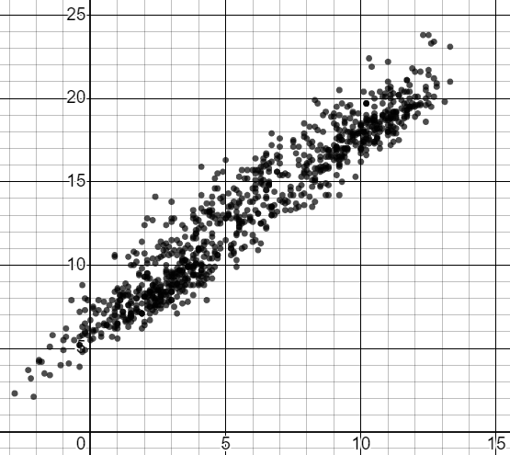
Using trends and interpolation to make predictions
The scatter graph shows data about the weather in Armagh for each month from 1941 to 2022.
Given the following minimum daily temperatures, estimate the range of maximum daily temperatures.
mean of daily maximum temperature (℃)
a) minimum: 10℃
maximum:
between
___
and
___
℃
b) minimum: 5℃
maximum:
between
___
and
___
℃
c) minimum: 0℃
mean of daily minimum temperature (℃)
maximum:
between
___
and
___
℃

Slide 42
Using trends and interpolation to make predictions
The scatter graph shows data about the weather in Armagh for each month from 1941 to 2022.
Given the following minimum daily temperatures, estimate the range of maximum daily temperatures.
mean of daily maximum temperature (℃)
a) minimum: 10℃
maximum:
between
16
and
20
℃
b) minimum: 5℃
maximum:
between
10
and
15
℃
c) minimum: 0℃
mean of daily minimum temperature (℃)
maximum:
between
5
and
8
℃

Slide 43
Interpreting scatter graphs
A general trend may be observed from a scatter graph.
Scatter graphs can be used to estimate a second value when the first value is known, using interpolation.
Extrapolation may not be valid as this is outside the data set.

Slide 44

© Oak National Academy 2023.
Produced in partnership with Mathematics in Education and Industry.
Licensed on the Open Government Licence v3.0, except where otherwise stated. See Oak terms and conditions.

